Slide 1

MMXIX
Notes:
OPENER: SHERRELL

Slide 2


SURGEON GENERAL’S HEALTH WARNING
THIS PPT IS AVAILABLE ON GITHUB & SLACK ALL NIGHT
GITHUB: HTTPS://GITHUB.COM/TRESATA/HACKATHONCLT2019 SLACK: HTTPS://HACKATHONCLT2019.SLACK.COM
Notes:
KRISTEN

Slide 3
JUST LIKE ALWAYS
3 – THE MAX NUMBER OF PARTICIPANTS PER TEAM
3 – CATEGORIES YOU CAN PARTICIPATE IN (HACK, CODE, FREESTYLE)
3 – KEYS FOR THE NIGHT (TECH, SPACE, FOOD)
Notes:
KRISTEN

Slide 4
NEW THIS YEAR – FULLY DIGITAL PLATFORM
YOUR TEAM MUST CREATE A DEVPOST ACCOUNT BEFORE 9PM TONIGHT
Notes:
KRISTEN

Slide 5
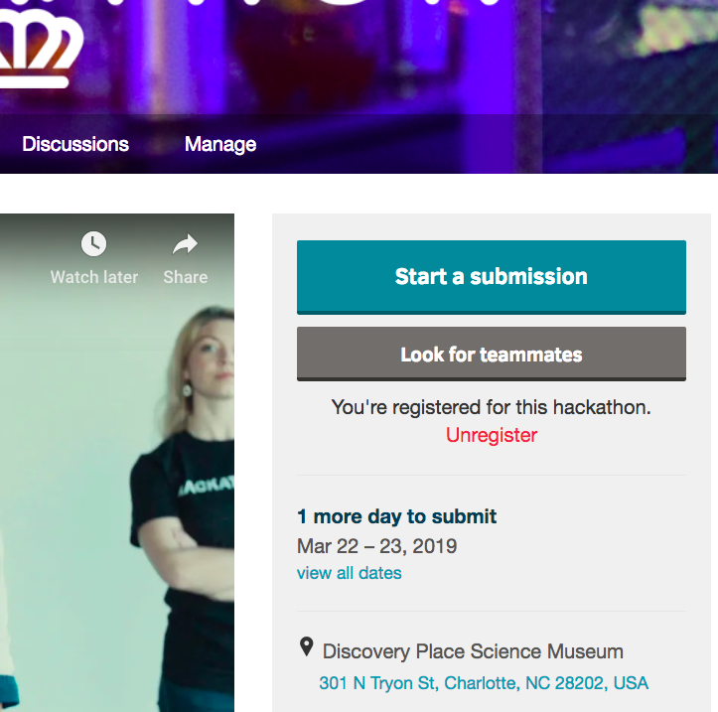
SO EASY EVEN A HACKER CAN DO IT – DEVPOST BASICS
START A SUBMISSION
ADD A NEW PROJECT
PROJECT NAME == TEAM NAME
CONFIRM YOU’RE NOT A ROBOT
Notes:
KRISTEN

Slide 6
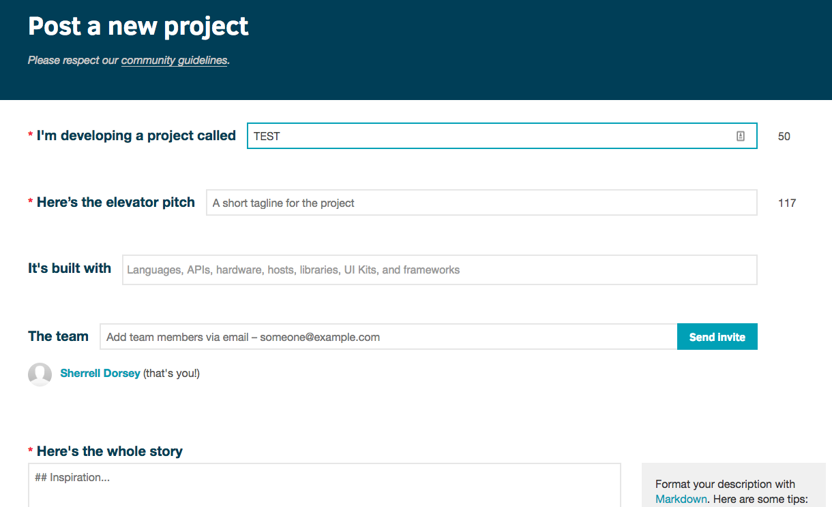
HACK THE SYSTEM
POST YOUR NEW PROJECT
UPLOAD FILE … AFTER SUBMISSION
SUBMIT
READY TO ROCK AND CODE
Notes:
KRISTEN

Slide 7
ALSO NEW FOR THIS YEAR
SHORTLISTING AND FINAL JUDGING IN DEVPOST
SUBMISSIONS TO DEVPOST COULD INCLUDE
THE LINK TO YOUR TEAM’S GITHUB REPO WITH ANY SCRIPTS
PRESENTATION SLIDES (I.E. PPT)
ANY OTHER CONTENT YOU GENERATE
JUDGING CRITERIA - SMALL IMPROVEMENTS
AGENDA UPDATES
NUMBER OF TEAMS SELECTED TO ADVANCE (MORE ON THIS IN A MOMENT)
Notes:
KRISTEN

Slide 8
IF YOU WANT TO WIN…
ONE DEVPOST SUBMISSION PER TEAM
MUST SUBMIT BEFORE SHORTLISTING (8:45 AM)
DON’T BREAK ANY RULES
DON’T EVEN THINK ABOUT TAKING THE DATA WITH YOU
Notes:
KRISTEN

Slide 9
LOGISTICS
Notes:
KRISTEN

Slide 10
GET A CONNECTION
FIND WIFI: DISCOVERYPLACEWIFI
FIND THE DATA - SERVER AND DATA ACCESS WILL BE GIVEN IN THE TECH COMMAND CENTER
FIND AN ID - ONE ID PER TEAM
FIND A NAME – FOR YOUR TEAM…MAKE IT FUN
Notes:
KRISTEN

Slide 11
RULES OF ENGAGEMENT
NOTHING ILLEGAL
RESPECT COPYRIGHT
KEEP IT CLEAN
TERMS & CONDITIONS
ALL WORK MUST BE DONE ON-SITE
ORGANIZERS RESERVE THE RIGHT …
YOU CANNOT LEAVE WITH ANY DATA OR SOFTWARE ON YOUR DEVICES…AND…
Notes:
KRISTEN
AS WITH PREVIOUS YEARS, THE RESTRICTED AREAS INCLUDE THE THIRD FLOOR, THE CAFETERIA ON THE FIRST FLOOR, AND OF COURSE ANYTHING LOCKED LIKE THE IMAX THEATRE.
OUR SECURITY TEAM WILL BE PATROLLING THROUGHOUT THE NIGHT TO REMIND ANYONE THAT STARTS TO FEEL A LITTLE TOO ADVENTUROUS.

Slide 12
DATA PRIVACY DO’S AND DON’T’S
HACKATHONCLT DATA
IS CONFIDENTIAL
CAN ONLY BE USED DURING HACKATHONCLT 2019
IS NOT TO BE DOWNLOADED / USED FOR ANY OTHER PURPOSE
DO NOT
ATTEMPT TO IDENTIFY ANY DE-IDENTIFIED INFORMATION.
ATTEMPT TO CONTACT INDIVIDUALS WHO ARE SUBJECTS OF THE INFORMATION.
KEEP DATA OR SOFTWARE AFTER THE HACKATHON. LAPTOP CHECK BEFORE EXIT.
MIGRATE DATA TO ANY OTHER WEB SERVICE OR PLATFORM (I.E. AMAZON)
IF YOU DON’T COMPLY, YOUR TEAM WILL BE DISQUALIFIED.
Notes:
KRISTEN – THIS IS THE MOST IMPORTANT POINT IN THIS SECTION
IF ANYONE BREAKS THIS…YOU WILL BE DISQUALIFIED
THIS IS DATA ABOUT HUMAN BEING YOU LIVE WITH IN THIS CITY
MASSIVE FED REQS
JUST DON’T DO ANYTHING STUPID
TREAT THIS LIKE YOU WOULD YOUR OWN HEALTH DATA
AND IF YOU WOULD BE

Slide 13
THERE IS ONE THING YOU CANNOT DO
CAFÉ IS OFF-LIMITS.
DO NOT ENTER/MOVE/RELOCATE
OR FACE MY WRATH
Notes:
KRISTEN
AS WITH PREVIOUS YEARS, THE RESTRICTED AREAS INCLUDE THE THIRD FLOOR, THE CAFETERIA ON THE FIRST FLOOR, AND OF COURSE ANYTHING LOCKED LIKE THE IMAX THEATRE.
OUR SECURITY TEAM WILL BE PATROLLING THROUGHOUT THE NIGHT TO REMIND ANYONE THAT STARTS TO FEEL A LITTLE TOO ADVENTUROUS.

Slide 14
PARTY TIME
WHEN | WHAT’S GOING ON | WHERE
8:15PM | RELEASE THE HACKERS! (CODING BEGINS) | EVERYWHERE
10:00PM | ANIMAL ENCOUNTER | STAGE – LEVEL 2
11:00PM | LIQUID NITROGEN COFFEE | STAGE – LEVEL 2
11:30PM | HACKER TIPS & TRICKS | STAGE – LEVEL 2
12:00AM | MIDNIGHT SNACK | COOL STUFF – LEVEL 2
1:30AM | HACKER TIPS & TRICKS | STAGE – LEVEL 2
3:30AM | HACKER TIPS & TRICKS | STAGE – LEVEL 2
4:00AM | OPEN MIC STAND UP | STAGE – LEVEL 2
6:15AM | BREAKFAST HACKER TIPS & TRICKS | COOL STUFF – LEVEL 2 STAGE – LEVEL 2
9:00AM | MUSEUM OPENS (YOU ARE THE EXHIBIT!) | EVERYWHERE
Notes:
KRISTEN
NO NEED TO TAKE NOTES, THESE ACTIVTIES WILL BE ANNOUNCED ON SLACK AND THE COMPLETE AGENDA WILL ROTATE ON THE TV SCREENS IN THE MUSEUM
HACKER TIPS & TRICKS – TRESATA DATA ENGINEERS WILL BE AVAILABLE TO ANSWER YOUR BURNING DATA QUESTIONS IN PERSON
HAVE YOU WATCHED THE MARVELOUS MS MAISEL? IT’S SO FUNNY… ANYWAY, OPEN MIC IS JUST LIKE THAT.

Slide 15
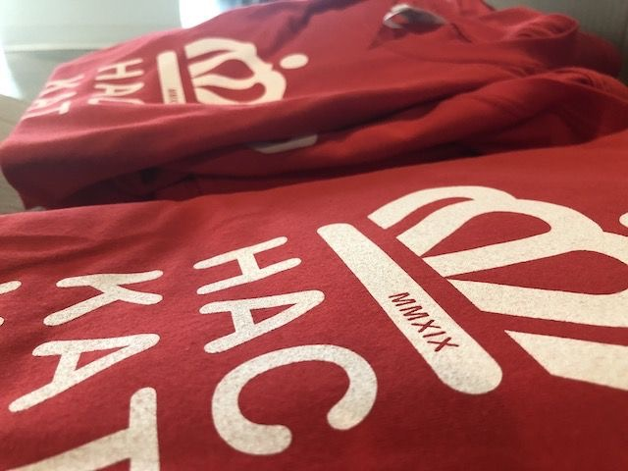
PARTY TIME
Notes:
KRISTEN
NO NEED TO TAKE NOTES, THESE ACTIVTIES WILL BE ANNOUNCED ON SLACK AND THE COMPLETE AGENDA WILL ROTATE ON THE TV SCREENS IN THE MUSEUM
HACKER TIPS & TRICKS – TRESATA DATA ENGINEERS WILL BE AVAILABLE TO ANSWER YOUR BURNING DATA QUESTIONS IN PERSON
HAVE YOU WATCHED THE MARVELOUS MS MAISEL? IT’S SO FUNNY… ANYWAY, OPEN MIC IS JUST LIKE THAT.

Slide 16
THE PROBLEM
Notes:
PAT

Slide 17
WHAT IS MEDLINK?
SAFETY-NET SERVICE PROVIDERS COLLABORATING
IMPROVE COMMUNITY’S ACCESS TO HEALTH CARE
REGARDLESS OF ABILITY TO PAY
20 CLINICS IN MECKLENBURG COUNTY
HTTPS://MEDLINKOFMECKLENBURG.ORG/
Notes:
PAT

Slide 18



















Notes:
PAT

Slide 19
UP ALL NIGHT FOR A CAUSE
THE BENEFICIARY – MEDLINK
THE PROBLEM – ACCESS TO CARE AND PREVENTATIVE SERVICES
THE POSSIBLE APPROACHES –
CREATE UNIVERSAL DATA PORTAL FOR MEDLINK PARTNERS
IMPROVE ACCESS TO CARE FOR SPECIFIC HEALTH PROBLEMS
DETERMINE CAUSES OF GAPS IN HEALTH CARE ACCESS
UNDERSTAND HOW GEOGRAPHIC AND SOCIAL CONTEXT AFFECTS ACCESS
ANY OTHER SOLUTIONS YOU CAN DREAM UP (THE PATHWAYS ARE ENDLESS)
THE AGENT OF CHANGE – YOU
Notes:
PATRICK – JAMIE SUNDE

Slide 20
WAYS TO PLAY
Notes:
NORA

Slide 21
WAYS TO COMPETE
THE HACK
FOR HACKATHON PURISTS, THIS CATEGORY DEMANDS HACKING, CODING AND ANALYTICAL TALENT WHERE THE WINNERS WILL BE JUDGED ON THE QUALITY OF PREDICTIONS AND SCALABILITY OF CODE (REMEMBER “BIG DATA HACKATHON”) THAT IS ABLE TO SOLVE THE BUSINESS PROBLEM.
THE CODE
WELL, YOU GOT IT. IN ORDER TO WIN…YOU NEED TO WRITE SOME CODE. IT CAN BE ANYTHING FROM MOBILE APPLICATIONS TO WEBSITES AND EVERYTHING IN BETWEEN, AS LONG AS IT HELPS SOLVE THE BUSINESS PROBLEM.
THE FREESTYLE
WE BELIEVE THAT CREATIVITY CAN BE HACKED AS WELL!! SO THIS ONE IS FOR THE ARTISTS, THE VAGABONDS WHO CAN’T CODE (YET) BUT STILL DREAM ABOUT MAKING THE WORLD A BETTER PLACE WITH LATERAL, “NEVER-BEFORE-THOUGHT-OF” IDEAS. DELIVER A KILLER-PREZ BACKED BY A SOLID, SCALABLE, BUSINESS MODEL THAT CONVINCINGLY PROVES THAT YOU CAN SOLVE THE BUSINESS PROBLEM, AND YOU TOO CAN WIN.
Notes:
NORA

Slide 22
QUICK TIP: KEEP YOUR COMPETITIVE EDGE
EACH TEAM MUST CHOOSE ONE OF THE THREE CATEGORIES
HACK, CODE, FREESTYLE – BUT ONLY ONE
PUT THE CHOSEN CATEGORY IN DEVPOST SUBMISSION COMMENTS
TEAMS CAN CHANGE THEIR CATEGORY OVERNIGHT
DON’T SWEAT IT! JUST CHANGE YOUR DEVPOST COMMENT
Notes:
NORA

Slide 23
JUDGING
SUBMISSIONS WILL BE RANKED ON THE FOLLOWING:
SCALABILITY
MODEL QUALITY
CREATIVITY
PRESENTATION
IMPLEMENTABILITY
Notes:
DULIN
MODEL = CODE OR BIZ

Slide 24
TRUST THE PROCESS
SHORTLISTING
- COME WITH YOUR BEST 3-MINUTE PITCH - SIGN UP FOR APPOINTMENTS VIA GOOGLE SPREADSHEET; LINK WILL BE ON SLACK - MAKE SURE TO HAVE YOUR SUBMISSION IN DEVPOST PRIOR TO SCHEDULED SHORTLISTING
FINAL JUDGING
- 7 TEAMS – 2 TEAMS FOR EACH CATEGORY (HACK, CODE, FREESTYLE) + 1 WILDCARD - 3-MINUTE PITCH + Q/A SESSION
Notes:
DULIN

Slide 25
TIME TO BE JUDGY
MARCH 23, 2019 | JUDGING STAGE | WHO | WHERE
6AM | SHORTLISTING (LIMITED CAPACITY) | OUR EARLY FINISHERS | COMMAND CENTER (KIDSU)
7AM | SHORTLISTING (FULL CAPACITY) | EVERYBODY | COMMAND CENTER (KIDSU)
8:45 AM | END OF HACKING | EVERYBODY NEEDS TO BE DONE BY THIS TIME | WESTEROS
9:00 AM | END OF SHORTLISTING | EVERYBODY NEEDS TO HAVE SEEN A SHORTLISITING JUDGE BY THIS TIME | COMMAND CENTER (KIDSU)
10:00 AM | FINALIST PRESENTATIONS & AWARDS | EVERYONE WHO WENT THROUGH SHORTLISTING | AUDITORIUM
12:00 PM | EVENT ENDS | WE ALL GO HOME | EVERYWHERE
Notes:
DULIN

Slide 26
QUICK TIP: READY FOR JUDGMENT
BE CLEAR AND CLEAN IN THREE MINUTES
SIGN UP FOR SHORTLISTING IN ADVANCE
Notes:
DULIN

Slide 27
DATA + TECH
Notes:
VICTORIA

Slide 28
STACK & SLACK
FREE TO USE ANYTHING THAT CAN COMPILE TO A .JAR (JAVA, SCALA, ETC)
DATA STORED ON HDFS (HADOOP DISTRIBUTED FILE SYSTEM) & ON HACKER SERVERS
CREATE WORKING DIRECTORY FOR YOUR TEAM’S DATA ANALYSIS (SEE GITHUB README)
TOOLS FOR YOUR HACKING PLEASURE: R, SPARK, ANACONDA, PYSPARK, HIVE, ELASTICSEARCH
Notes:
VICTORIA

Slide 29
STACK & SLACK
YOU ASKED FOR IT: TRESATA TREK (SEE NEXT SLIDE FOR ACCESS INFO)
DATA DESCRIPTIONS, DICTIONARIES ON GITHUB (HTTPS://GITHUB.COM/TRESATA/HACKATHONCLT2019)
STAY INFORMED AND COMMUNICATE ON SLACK (HTTPS://HACKATHONCLT2019.SLACK.COM)
SUBMIT CONTENT FOR JUDGING ON DEVPOST (HTTPS://HACKATHONCLT.DEVPOST.COM)
Notes:
VICTORIA

Slide 30
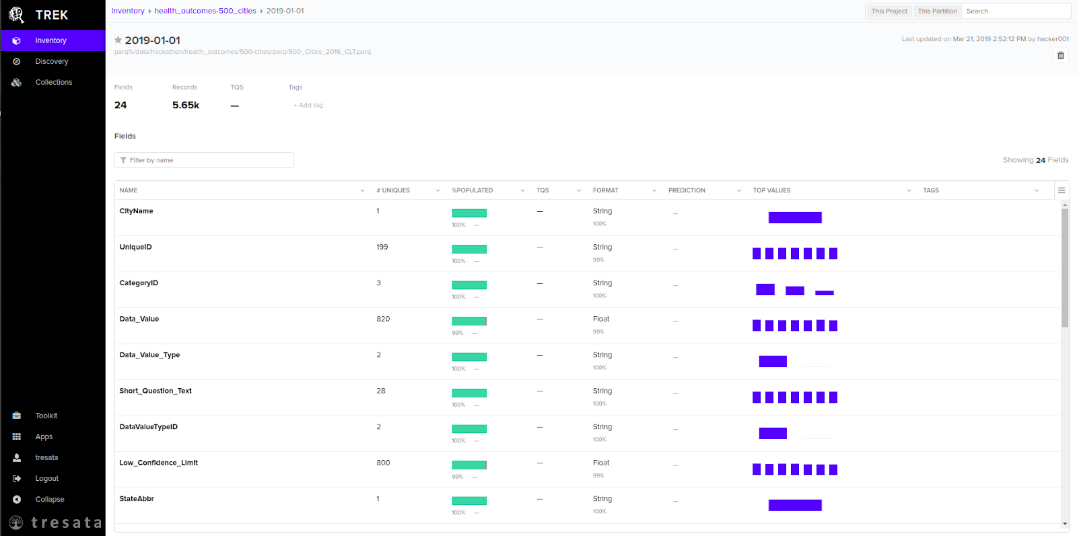
TRESATA TREK: DATA DISCOVERY
CONNECT @ HACK01.NORTHSTATE.NET:5603
Notes:
VICTORIA

Slide 31
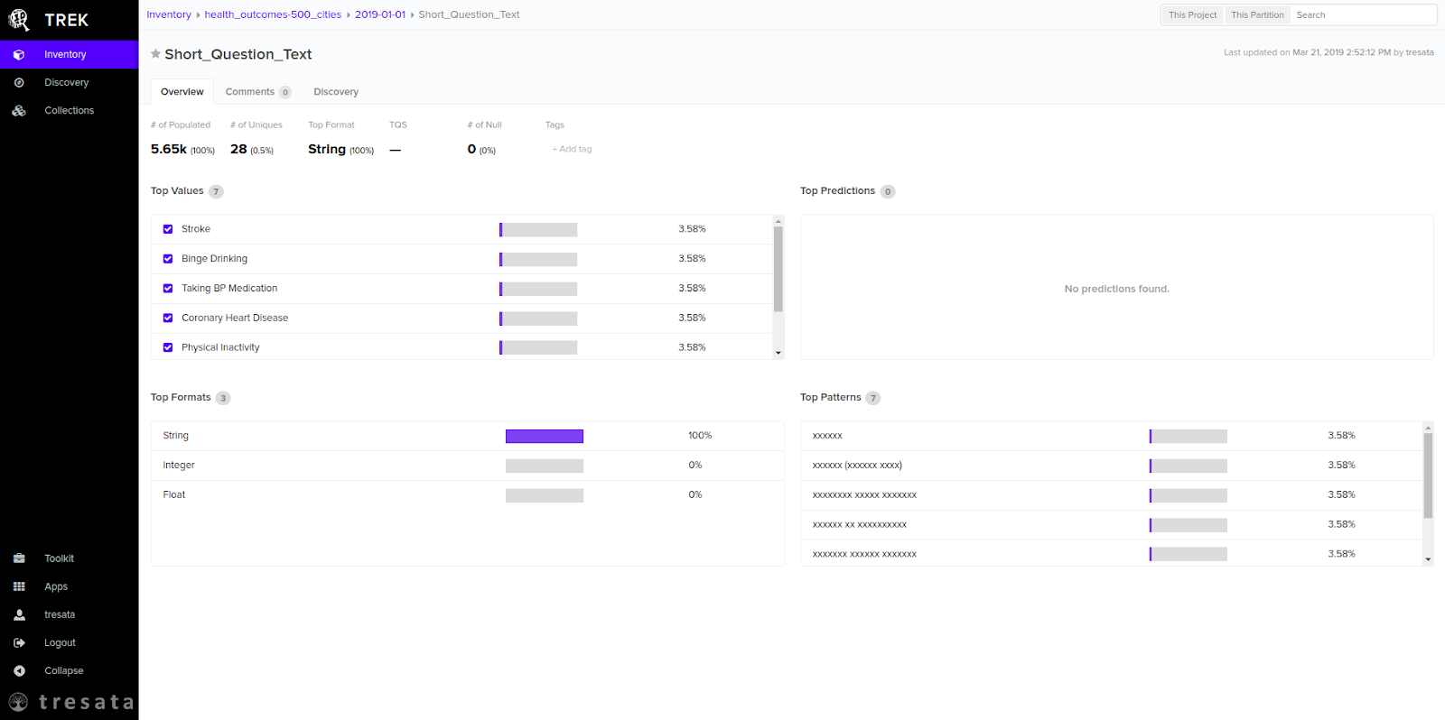
TRESATA TREK: DATA DISCOVERY
CONNECT @ HACK01.NORTHSTATE.NET:5603
Notes:
VICTORIA

Slide 32
DATA DATA DATA
Individuals’ behaviors, lifestyle habits, disease prevalence, etc. aggregated at zip code or census tract level in Meck. County
HEALTH OUTCOMES DATASETS
CDC 500 CITIES PROJECT (CHARLOTTE ONLY)
AIDSVU (HIV)
SERVICES DATASETS FROM MEDLINK PARTNERS
CAMINO CLINIC
CARE RING
CHARLOTTE COMMUNITY HEALTH CLINIC
CHARLOTTE CENTER FOR LEGAL ADVOCACY
MECKLENBURG COUNTY PUBLIC HEALTH
NC MEDASSIST
Client visits in 2018 for each agency aggregated by zip code, sex, and race/ethnicity in Meck. County
Notes:
VICTORIA
500 Cities-Health outcomes, prevention, unhealthy behaviors by zip code in Charlotte
Medlink—

Slide 33
DATA DATA DATA
SOCIAL DETERMINANTS OF HEALTH (SDH) DATASETS
CENSUS
CHARLOTTE HOUSING AUTHORITY
CONSUMER FINANCIAL PROTECTION BUREAU
EPA
GEO-MAPPINGS
HOUSING & URBAN DEVELOPMENT
MECKLENBURG PUBLIC SERVICES-GEO JSON
MECKLENBURG QUALITY OF LIFE
NC BOARD OF EDUCATION
ZILLOW
ANY OTHER OPEN-SOURCE DATASETS ARE FAIR GAME
Contextual factors that influence health, such as race, income, environment, transportation, etc.
Notes:
VICTORIA
500 Cities-Health outcomes, prevention, unhealthy behaviors by zip code in Charlotte
Update with final list from Brandon

Slide 34
FINAL TIP: SOCIAL MEDIA
LEVERAGE THE INTERNET TO HACK THE PROBLEM
GOOGLE TRENDS, TWITTER, ANYTHING YOU CAN IMAGINE (CHECK README IN GITHUB)
POST PICTURES THROUGHOUT YOUR HACKATHON JOURNEY
USE OUR HASHTAGS AND TAG SOCIAL MEDIA ACCOUNTS DISPLAYED THROUGHOUT THE MUSEUM
Notes:
NORA

Slide 35
Q & A
Notes:
Everybody

Slide 36
#CLTHACKSALOT
@charlottehacks
#hackathonCLT

